Slide 1
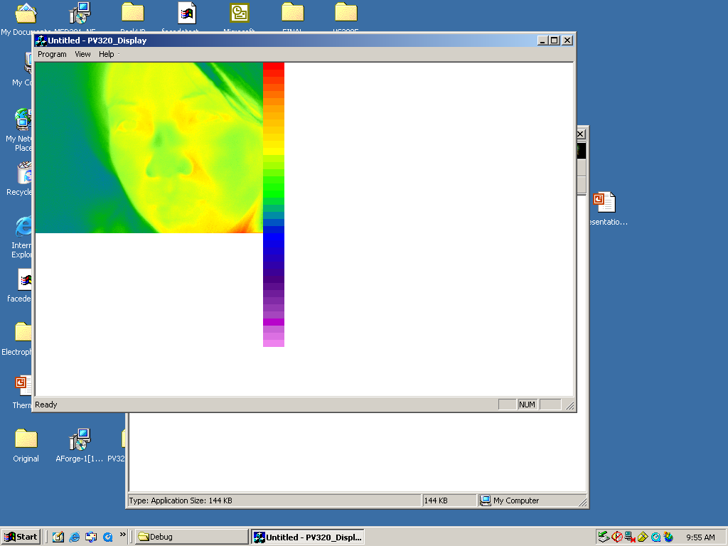
5 mins 14/07/2009

Slide 2
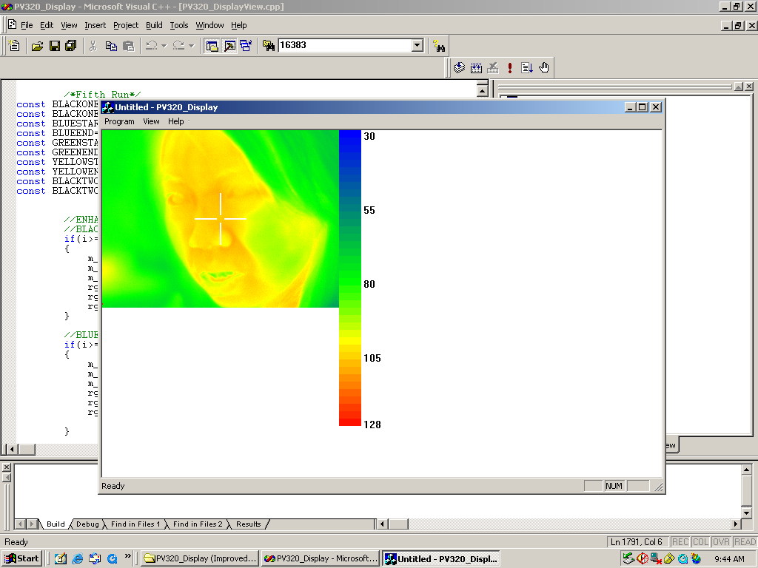
4th August
Gray level 50 to 128

